Slide 1
Welcome to The Villages Archery Club
Summer 300 League
The League:
The league is open to both club members and non-club members
The league will begin in mid July and will be about 12 weeks long (based on the number of participants)
Shooting will be at either range (Paradise and Dudley)
The preferred League shooting time is 9:00 Monday mornings at both Dudley and Paradise, but alternate times and days are allowed
There is a $10 entry fee, and all funds are used as prize money for the participants
There will be both team and individual prizes

Slide 2
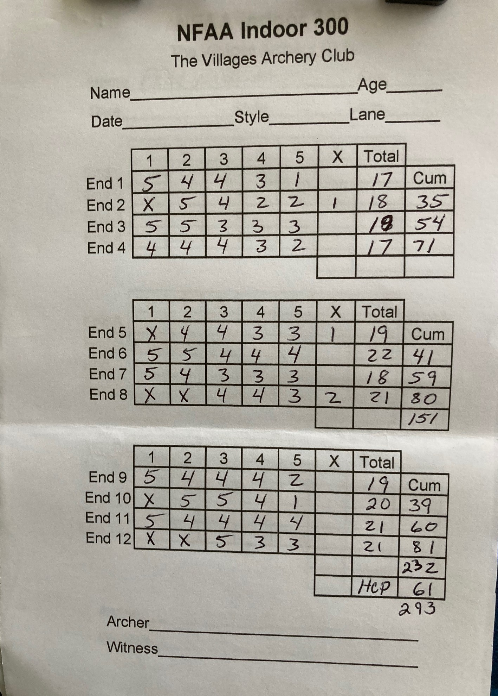
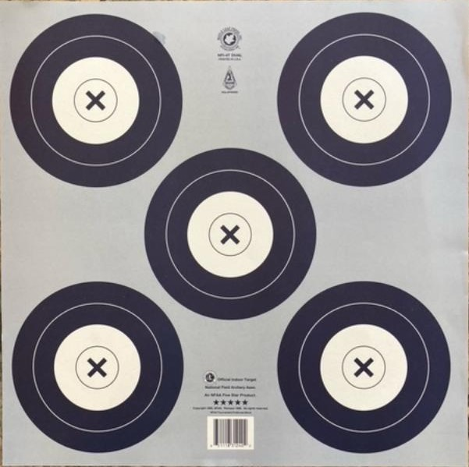
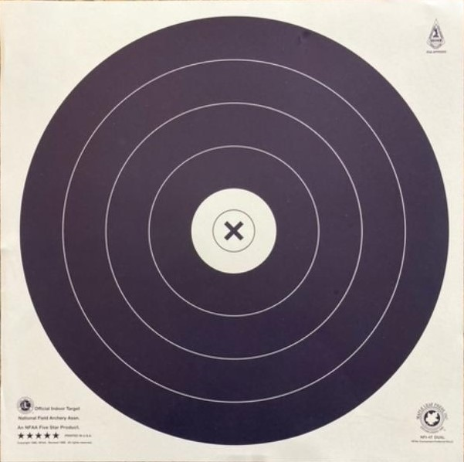
The Villages Archery Club Summer 300 League
What is a 300 (aka Indoor) round?
A 300 round is 12 ends of 5 arrows, for a total of 60 arrows
All ends are shot at 20 yards, regardless of equipment type
Each arrow is worth a potential of 5 points
We will be using the NFAA indoor targets
Single spot targets for Recurve and Barebow, and 5-spots for Compound shooters

Slide 3
The Villages Archery Club Summer 300 League
How does the League work?
Each archer will have a handicap (This levels the playing field and lets everyone be competitive, regardless of equipment or skill level)
Handicaps will be established prior to the league start
Participants will be combined into teams based on handicaps, so all teams are relatively equal
Each week, teams will be matched up and individual archers will be paired up with an opponent (again based on handicap/ranking)
The preferred League shooting time is 9:00 Monday mornings at both Dudley and Paradise
Archers will coordinate with their opponent to agree on a range, day and time to shoot
If you can’t align schedules, shooting with other league participants, pre-shooting, and individual shooting are allowed (with caveats)
Scores are to be submitted to the League Secretary each week via email

Slide 4
The Villages Archery Club Summer 300 League
Establishing a handicap:
The handicaps for this league are the difference between your average score and the maximum score of 300
Handicaps need to be established prior to league start
Each archer will need to shoot at least six 300 rounds, and submit their scorecards prior to the start of the league
Handicap rounds can be shot at either range
Score cards need to be photographed and emailed to jeffwiseman@comcast.net
Getting started:
Targets are available in the shop at Paradise and through the Club officers at Dudley
Targets should be reused as much as possible (both for practice and multiple 300 rounds)
Scorecards are available for download/printing on our website under the section titles “Summer League 2023”

Slide 5
Targets and Scoring
5
4
3
2
1
5
4
A 300 round is 12 ends of 5 arrows = 60 arrows

Slide 6
Scoring:
Each archer has a score card
2 people score each target
One calls out the scores
One writes down the scores
Both make sure the scores are correct
Scores are called/written from highest to lowest for each end
Xs count as 5, but are written as “X”
Each end is totaled and cumed
The total score, handicap and grand total are written at the bottom
Both archers sign each score card
Notes:
You will not have a handicap until the league begins.
We are not using Xs as tie breakers in this league

